Slide 1

Liberalizing MTPL Insurance Market in Macedonia
FIRST Initiative Funded Project
World Bank
IV th International Conference of Insurance
Ohrid, 2012

Slide 2
Benefits of a sound MTPL market liberalization
Best price for consumers, based on risk characteristics;
Level-playing field / fair competition for market players;
Advantageous to more technically sound players;
Faster and better payment of claims to consumers.
Brings market stability, growth and confidence

Slide 3
Positive developments
Good ground for MTPL liberalization
Establishment of Insurance Supervision Agency, increased supervisory capacities and leading role in promoting insurance market development in Macedonia.
Law on Compulsory Motor TPL insurance in line with EU requirements;
Insurance Information Centre administered by the NIBM collecting market data and information useful for premium setting, reserving, detection of uninsured, fraud, etc.
Enhanced regulations and supervisory filing supported by web-based supervisory reporting system;
Combination of local expertise with practices of international groups with long insurance experience.

Slide 4
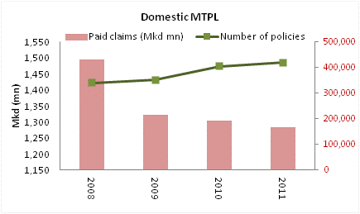
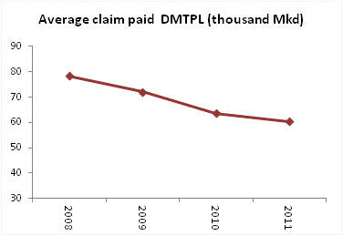
Liberalization challenges
Claims paying capacity issues
Increased number of vehicles and insurance policies
Increased number of claims reported to insurers
Increased domestic inflation and costs of auto repairs
BUT
Less amounts of claims paid back to consumers in Domestic MTPL business

Slide 5
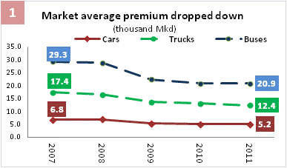
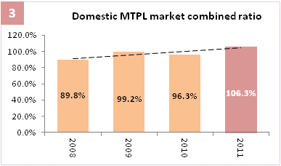
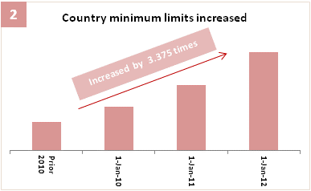
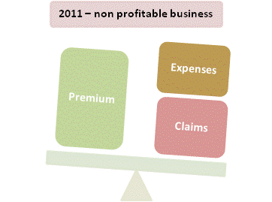
Liberalization challenges (contd.)
Effectiveness – Profitability issues (DMTPL)
4
<
Liberalization of MTPL market at current conditions would pose threats for insurers’ claims paying capacity and solvency and damage the reputation of insurance sector as a whole!

Slide 6
Liberalization challenges (contd.)
Market development issues
Current pricing system does not provide for proper actuarial risk pricing – which is essential driving mechanism in a liberalized market;
Insufficient reserving amounts to some companies’ running a short term ‘cash flow’ business;
Reinsurance regulation and enforcement (especially for motor green card);
Limited control by insurance companies over their production costs (premium discounts / high commissions);
Uninsured vehicles imposing additional costs on regular policyholders;
Policyholders’ credit risk associated with premium discounts;
No standardized approach by courts to claims awards;
Need for better data management , enhancing functionalities of Information Center and standardization of key tests and ratios.

Slide 7
Drawbacks of a premature liberalization
Competition without cost constraints due to inadequate market practices is likely to create market uncertainty:
Less responsible, but more aggressive insurers can potentially dominate the MTPL market through improper business practices:
- Reduced claims paying capacity;
- Deteriorated claims payment record;
- Questionable solvency.
- Insufficient premiums;
- Insufficient technical provisions;
- Improper reinsurance coverage.
Disadvantages from premature liberalization can outweigh the benefits.

Slide 8
Prerequisites for a sound market liberalization
Technical preconditions
Risk based actuarial
pricing
Proper
reserving
High quality reinsurance
Claims payment capacity
Enhanced solvency
Profitability
Confidence

Slide 9
Roadmap to MTPL insurance market liberalization
Current
Premiums fixed by MTPL insurance commission.
Transitional
(set standards)
Set a risk based pricing system, actuarial risk premium tariffs for risk groups;
Liberalized
Premium rates will be set individually by insurers;
Standards established in transitional period shall be used as:
Enact reinsurance regulation on the (a) net retention level and (b) quality of reinsurers
Guiding benchmark for insurers in establishing claims and IBNR reserves, setting premium rates and arranging reinsurance treaties;
Risk based criteria by the ISA in assessing MTPL claims paying capacity and solvency of insurers.
Establish actuarially sound market actuarial minimum reserving benchmarks;

Slide 10
Risk based pricing
Objectives
Security
Contribute to adequate level of reserves , satisfy reinsurance requirements, and guarantee solvency and future stability.
Operational
Generate profit, market share and market position for insurer considering changes in environment.
Consumer’s satisfaction
Provide clients with prices based on their risks - ensure affordability of premiums and quick payments of claims to third parties.

Slide 11
Risk based pricing
Current tariff adequacy
Insurance companies’ view
DMTPL
MTPL business is not profitable for most companies in the market!

Slide 12
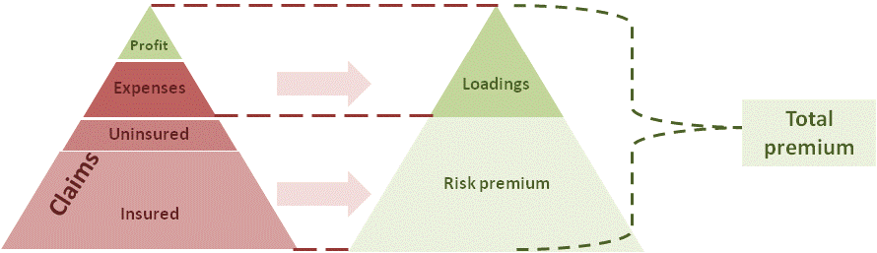
Risk based pricing
How much premiums?
Premiums: sufficient to pay claims (insured and uninsured), cover expenses and generate profit for insurer
Risk premium: sufficient to cover underlying risks (expected cost of claims from respective contracts) – largely independent from insurer
Loadings: sufficient to cover costs and generate targeted profit (subject to insurer’s effectiveness) – largely depending on insurer’s practices
Target: Combined ratio <100%

Slide 13
Risk based pricing
Determine risk premium rates
Objective
Total risk premiums are sufficient to timely pay claims arising from underlying risks and uninsured!
Same risk premium rate is allocated to risks of similar nature (homogeneity)
based on
Historical information and tendencies of:
Regulatory requirements
Market segmentation and growth
Market claims patterns
Other economic factors with impact in MTPL business

Slide 14
Risk based pricing
Process
Determine relevant and available Information, both qualitative and quantitative, – collect data (past experience)
Select risk classification model and procedure (divide portfolio into sub pools with different claim experiences: e.g. type of vehicle, age of driver, location, use, etc.)
Analyze data in accordance with model (frequency and severity distributions),
Select assumptions - inflation and superimposed inflation, environmental changes (e.g. change in policy limits)
Calculate expected levels of claim costs
Test results for variability and sensitivity (large claims, data volumes, etc)
Validate premium rates.

Slide 15
Risk based pricing
Data collection / availability
Historical information and tendencies:
Motor vehicle market (YES)
Development of country minimum insured limits (YES)
Data for homogenous risk groups
Number of insurance policies (YES)
Number of accidents and related insurance claims (YES)
Number of uninsured claims (YES)
Detailed claims data to be used to generate distributions in claims severities for material damage and bodily injury claims (not complete – missing details on reporting dates, category of vehicles, age of drivers, location, use of vehicle, etc.)
Specific impact of bodily injury claims settled through court procedures (statistical information – missing details)
Past and expected level of inflation and superimposed inflation (YES)

Slide 16
Risk based pricing
Rating factors
Vehicle category
Age group
Driving record
Vehicle use(personal, taxi, etc)
Impact of uninsured vehicles (premium contribution to guarantee fund).
Inflation and superimposed inflation
Location (?)
Age of driving license (?)

Slide 17
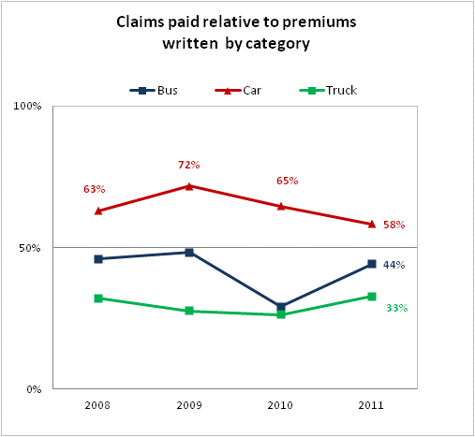
Risk based pricing
Considerations on rating factors- vehicle category
DMTPL
Personal vehicles (cars) have high claims ratio! Premiums written not sufficient to pay related losses and expenses!
Volatility for buses and trucks is high due to less frequent large losses in such categories.

Slide 18
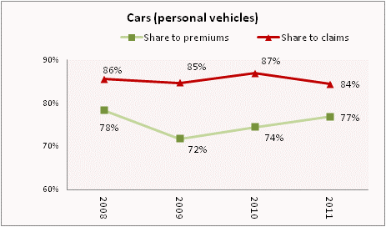
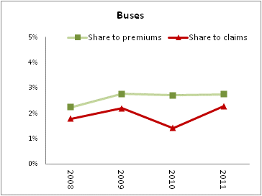
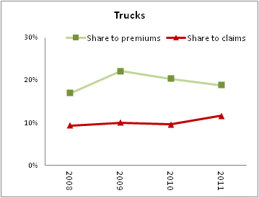
Risk based pricing
Vehicle category DMTPL (contd.)
About 85% of total market losses arise from cars - respective share in total premiums is 75%.
Sub-categories in category of cars (based on engine size or capacity ) shall enable proper pricing for highly different risks.
There is high loss volatility (due to low frequency /high severity nature) in categories of buses and trucks.

Slide 19
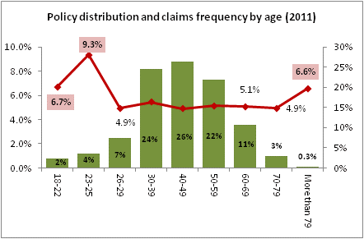
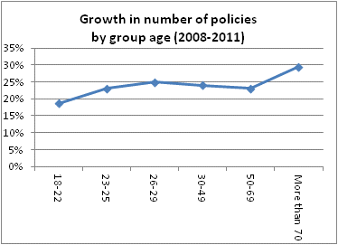
Risk based pricing
Rating factors DMTPL - Driver’s age
Higher claims records for very young and very old ages relative to number of policies.
Management information systems (Information Center and Insurers’ databases) should include information on claims severity relative to age and category of vehicle.
Cluster analysis is ongoing under the project for specification of (a) age risk groups and (b) relative difference in premium rates.

Slide 20
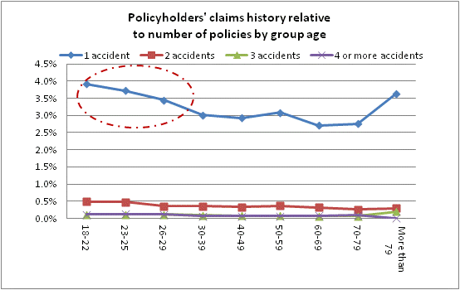
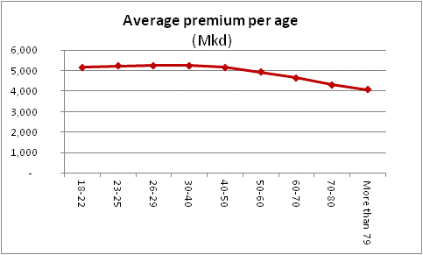
Risk based pricing
Rating factors DMTPL – claims experience
Young drivers have worse claims history
Average premium is almost flat for all group ages
Driver’s claims experience should be used rather than vehicle’s or owner’s history – liable driver has to pay a higher price!

Slide 21
Risk based pricing
Rating factors DMTPL– uninsured vehicles
Decreasing tendency of uninsured claims number relative to insured
Severity of uninsured claims substantially higher compared to insured claims (uninsured claims comprise 6% in number and 12% in amounts of claims paid)

Slide 22
Risk based pricing
Rating factors – Inflation and superimposed inflation)
Trends of economic macro inflation
Trends of additional superimposed inflation (repair costs, medical expenses, legal costs).
Changes in trends will be reflected in future claims payments and risk premium rates.

Slide 23
Risk based pricing
Procedure
Separate trends as to their effect on claims frequency and size and forecast separately
Identify period to which past data relate
Define period for which new tariffs shall apply
Identify period in which claims will arise;
Evaluate accuracy of available data vs accuracy required in projections
Specify model: segmentation, parameters / rating factors that will be used in calculations based on available market data.

Slide 24
Claims reserves
Impact in pricing
  Risk price = Overall level of claim cost per unit of risk
Claims reserves
Paid
Reported but not paid yet (outstanding)
Incurred but not reported yet (IBNR)
Can be reopened
Understated claims reserves
Inadequate risk premiums
Reduced claims paying capacity

Slide 25
Claims reserving process
Under project
Data collection (as mentioned in price section)
Choice of reserving model
Choice of assumptions (based on past experience and tendencies for future)
Assessment
Uncertainty analysis (statistical and sensitivity analysis with model and model parameters, conclusion on margins)

Slide 26
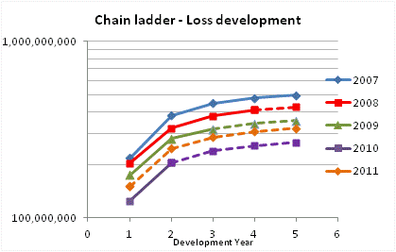
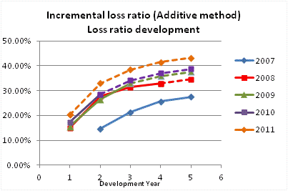

Claims reserving
Choice of model
Comparing models:
?
Parallel lines indicate consistent pattern
Crossing lines indicate inconsistent pattern
Chain ladder appears more consistent than Additive Method for domestic MTPL

Slide 27
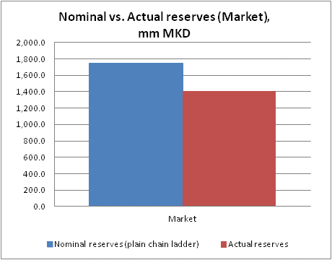
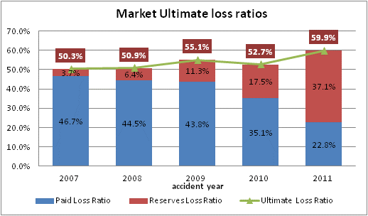
Claims reserving process
Preliminary results (based on claims from insured vehicles)
Domestic MTPL
Preliminary market results based on insured business only: claims ratio – 60%, claims reserve increased by about 23%.
Claims arising from uninsured vehicles are not included in claims ratio! An additional 6-9% increase in claims ratio is expected from uninsured claims.

Slide 28
Data management principles
Enhance Information Center functionalities
Types and quality of data used in reserving and pricing process is very important to ensure:
Best estimates of claims reserves + adequate risk based premiums
Best balance between insurer’s claims paying capacity
and affordable premiums for consumers
Enhance Information Center functionalities to ensure:
Accuracy
Minimize effect of missing data and errors
Flexibility
By rating factor (category, age, driving records, location, etc)
By type of claim (bodily injury, material damage)
By claim settlement history (court – out of court)
New business vs existing
Other
Homogeneity
Subdivision to level that guarantees high level of homogeneity
(e.g. – need for subdivision within category of personal vehicles)
Simplicity
Concise summary of statistical information.
Enable quick and reliable information based on simple data presentation

Slide 29
Reinsurance standards
Motor Green Card
Motor Green Card risk concentrated in EU countries
Increased risk of very large claims due to high applicable limits.
Most companies currently have good green card reinsurance programs arranged with high quality reinsurers.
Risk to skip good reinsurance practice in a liberalized market under fierce competition.
Increased MTPL limits may raise necessity of reinsurance for the domestic MTPL
Necessity for changes in regulatory requirements to introduce :
Maximum net retention level of insurers based on their net capacity and business volumes;
Minimum criteria on the credit quality of the leading or participating reinsurers;
Standard reporting/regulatory filing requirements for reinsurance programs.

Slide 30
Project deliverables
(Tariffs, Reserves, Reinsurance)
Main deliverables |  | Aim
Risk premium tariffs | Actuarial model and methodology for calculation of the MTPL benchmark risk premiums for major risk groups. | Guide tariff setting process in a liberalized market. Support RBS
 | Risk-based 'Benchmark Tariff - Setting Tool' in a well known format.
 | Transitional Risk Based MTPL tables of tariffs to be applied from insurers till market liberalization | Mandatory for insurers till market liberalization
Claims reserving | Actuarial methodology for the calculation (evaluation) of MTPL insurance claims provisions | Guide MTPL claims reserving before and post liberalization. Support RBS
 | MTPL claims reserving application in a well known format.
Reinsurance | Risk based recommendations on the types, amounts and quality of the outward Motor Green Card reinsurance | Guide and monitor MTPL reinsurance prior and post liberalization. Support RBS
More risk mgmt | A comprehensive early warning system to assess and control insurer’s MTPL risk | Support RBS of MTPL insurance
 | Technical recommendations on other MTPL insurance matters

Slide 31
Thank you

